Slide 1
PAX TEC Design
Status Report #1

Slide 2
Outline
PAX Emulator
  Design
  Initial measurements
PAX TEC
  Initial TEC selection
  Open loop measurements
Status and Plans

Slide 3
PAX Emulator
Similar physically and thermally to actual PAX
  Uses same thickness and R-value insulation
  Has numerous resistors to simulate total and distribution of PAX heat load
Temperature sensors (only one will be included on actual PAX to control temperature feedback loop)
  8 sensors to measure plate temperature at various locations
  1 sensor to measure PAX interior air temperature

Slide 4
PAX Emulator
Size and Power Distribution
Worst Case PAX
Our PAX Emulator
12 ½”
12 ½”
OTX
OTX
2.3 W
2.3 W
5 W
PAM
PAM
1.94 W
1.94 W
1.9 W
1.9 W
10 ¾”
10 ½”
Pwr Supply
1.6 W
1.45 W
10 W total
10.33 W total

Slide 5
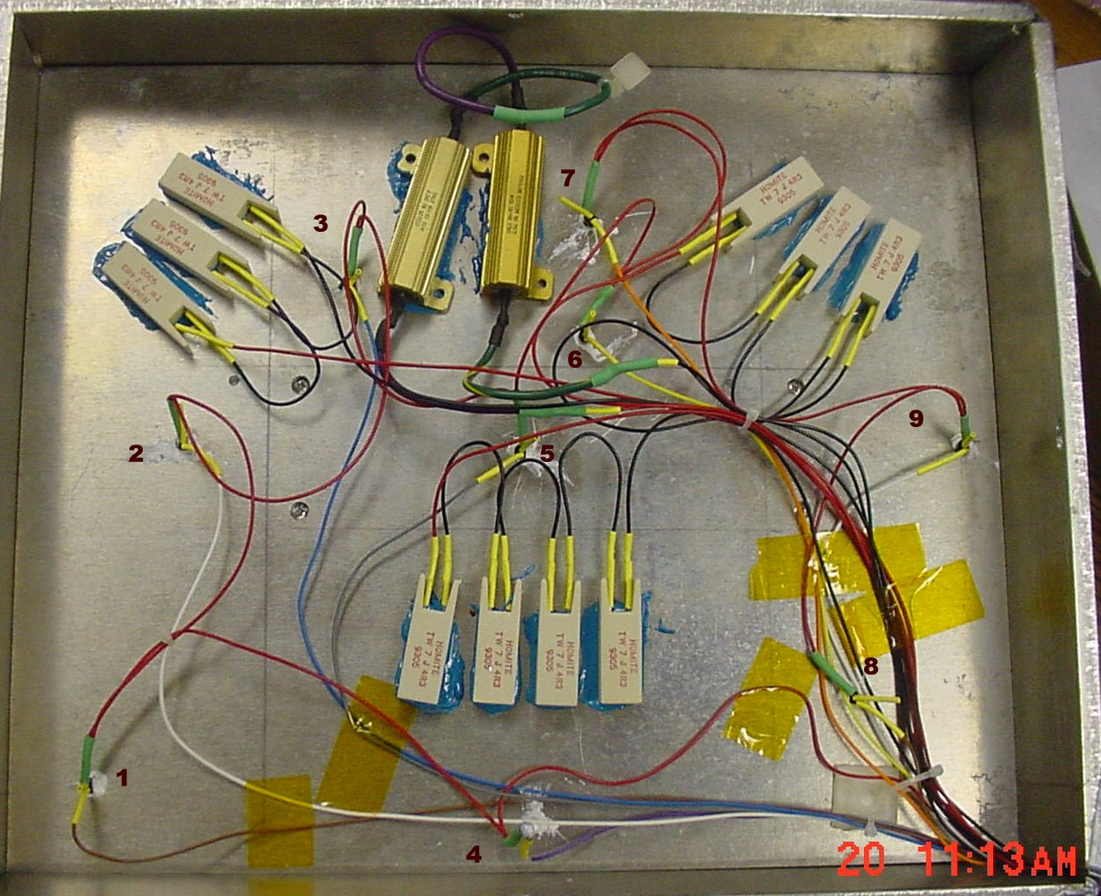
PAX Emulation Layout
Resistors =
approximate
Thermal Load
Temperature
Sensors
8 plate
1 air
TEC
TEC
Location of TEC’s
Mounted on under
Side of this plate
# 4 sensor = Air Temp

Slide 6
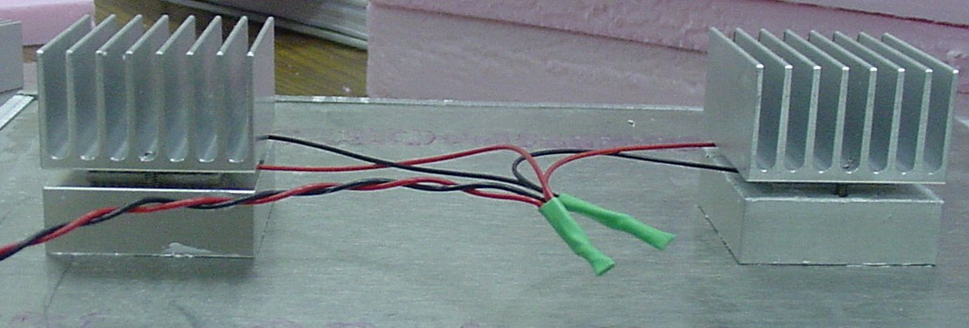
TEC Mountings
Under Side of PAX Base Plate
TEC mounted in between heat sink and aluminum block which elevates TEC off the PAX base plate to permit 0.9” rigid insulation to cover base plate.

Slide 7
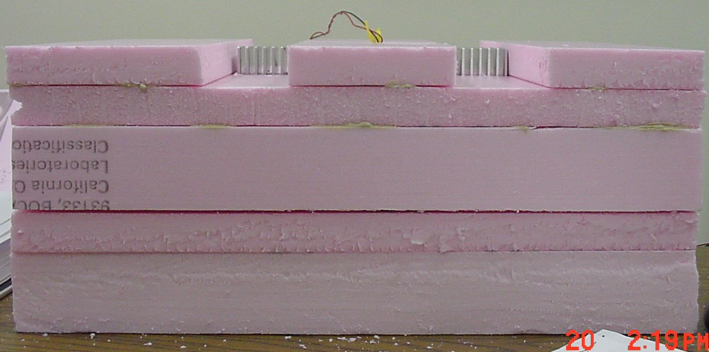
PAX Emulation : Side View
Insulation Installed
0.9”
~ 2”
PAX
Chassis
~ 3”
16.5”

Slide 8
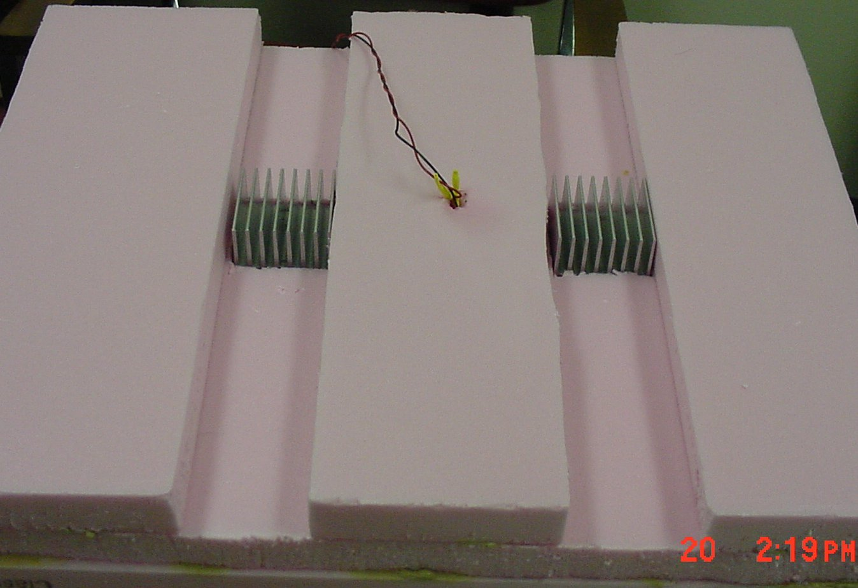
Air Cooling Channels

Slide 9
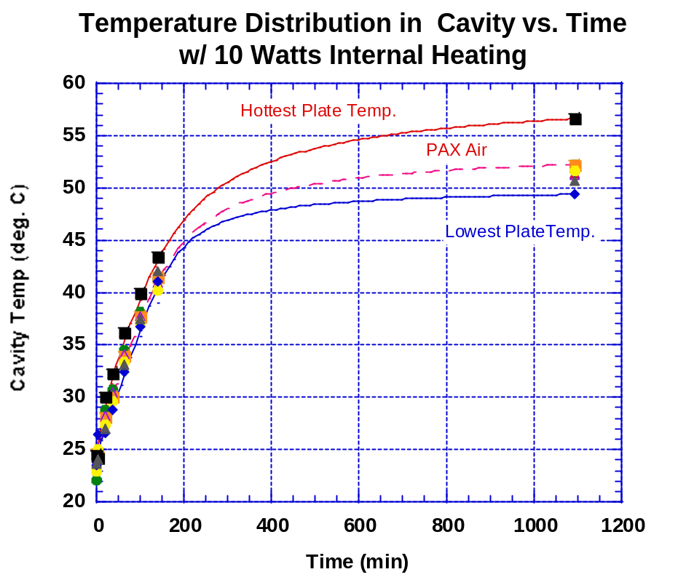
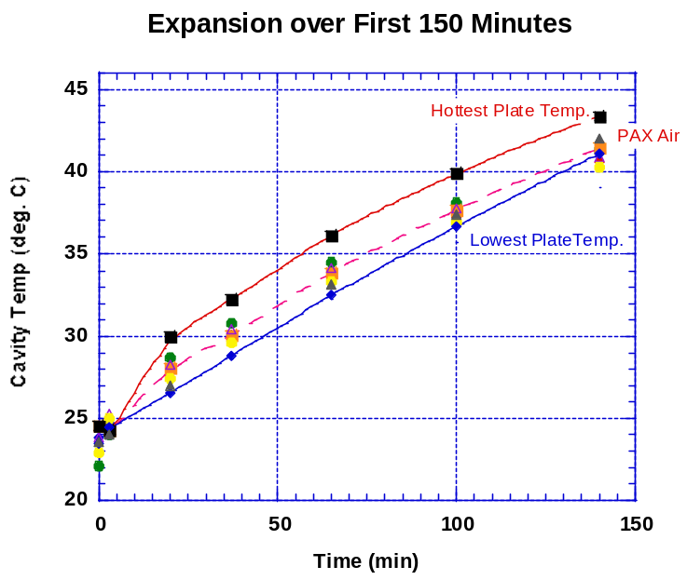
Change in PAX Temperatures
Conditions: 10 Watt Internal Heating; 23°C External Ambient

Slide 10
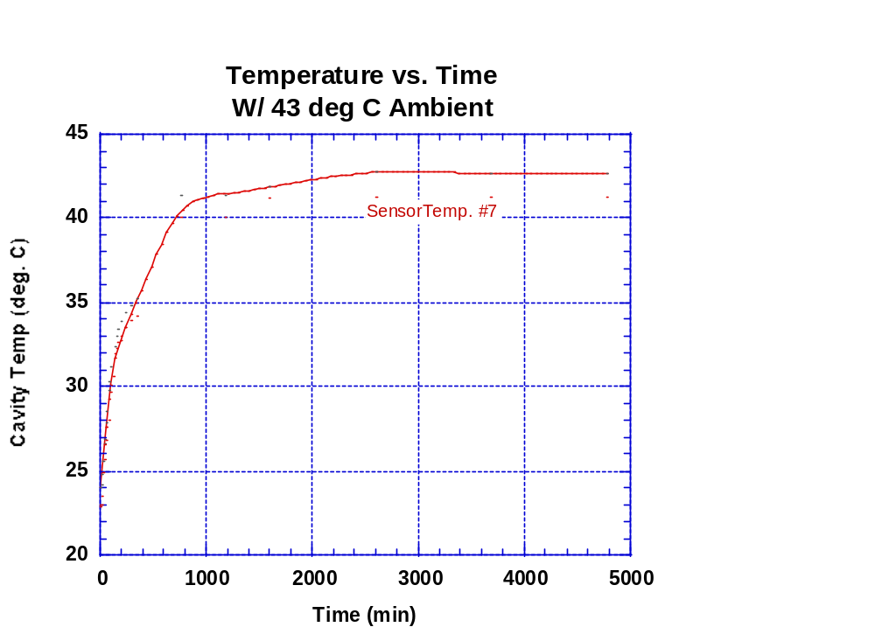
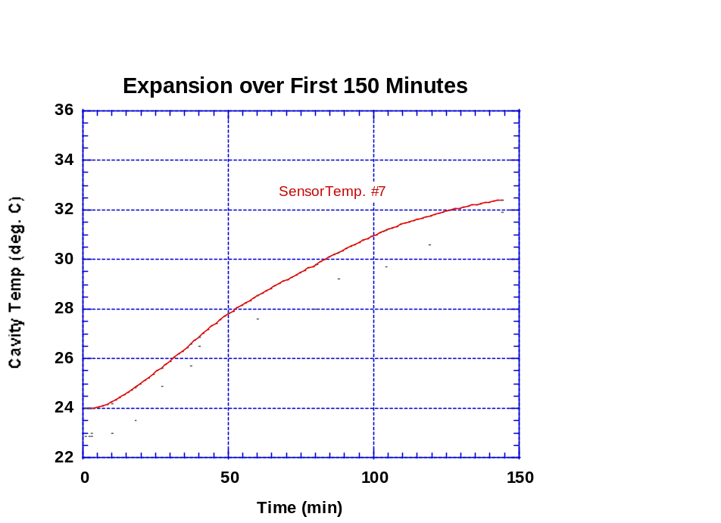
Change in PAX Temperatures
Conditions: No Internal Heating; 43°C External Ambient

Slide 11
Thermal Calculations and Models
PASSIVE POWER ESTIMATES
(heat leakage through Insulation)
R5 insulation equates to 0.0288 W/ (° K m)
Values in Inches Thickness
Top: 10.75 x 12.5 x 3
End: 12.5 x 2 x 2
Left: 10.75 x 2 x 2
Right: 10.75 x 2 x 2
Front: 12.5 x 2 x 1
Bottom: 10.75 x 8.9 x 1.8
8.95 x 3.6 x 0.9
TE (2) 1.8 x 1.8 x 0.2 (different k)
Total: 0.15626 W / ° C
For a 24 deg C difference between maximum user specified ambient and the PAX plate temperature (44 – 20 °C) this equates to 3.75 Watts
Experimental Equivalence found to be
closer to 4.99 Watts.
Conclusion: Assume 5 Watts Passive Power
ACTIVE POWER ESTIMATES
2 x OTX @ 2.3 W = 4.6 W
2 x PAM @ 1.9 W = 3.8 W
1 Power Supply = 1.6 W
TOTAL ACTIVE POWER = 10 Watts
TOTAL POWER TO DISSIPATE
for Worst Case Scenario
PASSIVE POWER 5 W
ACTIVE POWER 10 W
TOTAL 15 Watts

Slide 12
Thermal Calculations and Models – con’t
Assume cooling load, 15 Watts, could be provided by two TECs = 7.5 W each
Original choice for TEC w/ Qmax = 26 Watts
  Typical range of TEC COP: 25 – 40%
  Assume 30% COP (efficiency) for this TEC will provide 7.8 W cooling capacity
Extrusion typically provided in 6’ lengths
  Most economical way to mass produce required heat sinks
  However not all extrusions available in sample quantities
Initial Heat Sink: Wakefield #7293 Chosen
  Selected because available and nearly fit size constraint
  Height of 1.254” milled down to 1.036”
  Length cut to fit TE cooler = 1.845” long

Slide 13
First Set of Performance Measurements
Open Loop (No Control Circuit Yet)
 | T_{Ambient} | T_{PAX} – w/o TEC | T_{PAX} – w/TEC
No Load | 293°K | 293°K | 280°K
Load 10W | 293°K | 330°K | 293°K
Load 10W | 317- 321°K | >338 °K | 313°K
Conclusion: Cooling capacity of present TEC/heat sink combination is insufficient
to meet PAX heat load at high ambient.

Slide 14
PAX TEC Power Supply
1st Iteration
  12V @ 3A; 1.5 A per TEC
2nd Iteration
  3A per TEC ⇒ 6 A total
  TEC driver amplifier V_{out} = V_{in} – 4V @ 3A
    Need V_{out}, min = 11V ⇒ 15V supply rail
    Identified Meanwell power supply: 15V @ 6.7A ($48/in 100’s)

Slide 15
Status and Plans
Conclusions from 1st measurements
  2 TECs sufficient to maintain PAX plate temperature uniformity ( < 4°C maximum difference)
  Present combination of TECs and heat sinks insufficient to maintain PAX at desired temperature at high ambient
  Identified location of temperature sensor to use in temperature feedback loop
2nd iteration guidelines
  Stay with 2 TECs ( cost of 2 higher capacity units < 4 lower capacity units)
  Replace TECs with higher capacity units ( 38.7 vs. 26 W)
    Increase power supply current and voltage
  Reduce thermal resistance of heat sinks ( 10” long vs. ~ 2”)

